Slide 1
Voice Based
Fraud Detection System Using Speech Emotion Recognition
Supervisor – Dr. Rasika Rajapaksa
CS/2016/011

Slide 2
01
INTRODUCTION
RESEARCH PROBLEM
AIMS & OBJECTIVES

Slide 3
01
People try to claim for damages that have never happened
RESEARCH PROBLEM (INSURANCE SECTOR)
02
Existing systems do not satisfy the needs
03
Current manual fraud detection procedure is time consuming
04
Caller agents can’t predict caller’s behaviour

Slide 4
AIMS
Analyze calls
Detect Emotions
Emotions of the caller
Predict whether the caller is suspicious or not
Reduce cost
Reduce time
Reduce the staff and resources
Investigation time will be reduced
Past calls analysis
Support multiple Languages
Can input the audios stored in the databases and analyse
Audio Waves will be analysed

Slide 5
OBJECTIVES
WEB APPLICATION
User friendly Interface which helps to interact wide range of people including the people with low computer literacy
PROVIDE ANALYTICS
Using an existing dataset or
a dataset from insurance company
ACCURATE MODEL
Progress bars or charts to visualize the data

Slide 6
02
MOTIVATION

Slide 7
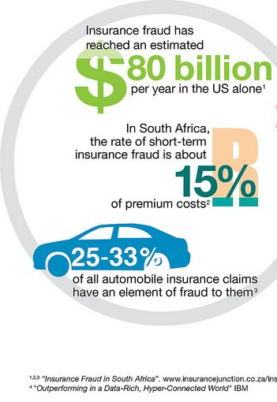
MOTIVATION
Global cost of Insurance fraud is
becoming high
Call centre cost is high
Do not have automated systems
Many unsolved cases to solve

Slide 8
03
LITERATURE SURVEY

Slide 9
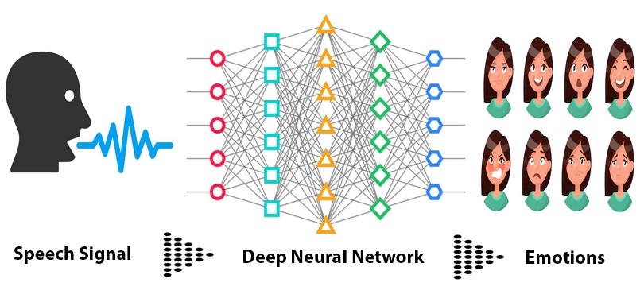
LITERATURE SURVEY
Research team of Seoul National University proposed a system for Multimodal Speech Emotion Recognition Using Audio and Text
Since 1920 researchers and scholars have taken this research area forward through numerous methods. Deep learning has improved the mechanism of recognizing human emotions from speech but still, there are some loopholes in the research of SER such as a shortage of data and insufficient accuracy of the trained models. The first SER model based on deep learning was proposed in 2014 by Han et al.

Slide 10
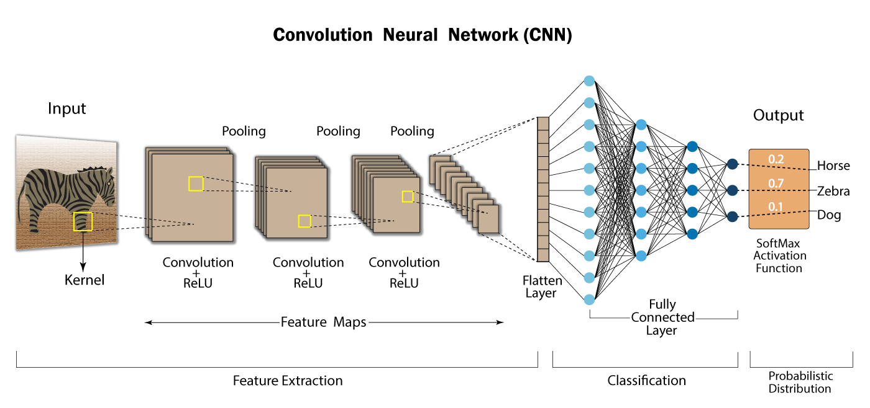
LITERATURE SURVEY
Research done by University of Missouri proposed a novel solution for SER using deep learning techniques. They have used Convolutional Neural Network (CNN) technique to classify speech emotions
Research paper that was published in 2018 presented a novel treasure-hunting game which can detect lies.

Slide 11
04
REQUIREMENTS SPECIFICATION

Slide 12
FUNCTIONAL AND NON-FUNCTIONAL REQUIREMENTS
Customers details and recording should be stored in a secure way
The proposed model should be able to identify the emotions of the caller
Must be able to work in different languages other than English
Caller agent should be able to record the call and get the result in real-time
Model should be able to identify the high-pitched voices and silences to detect audios that are suspicious
UI should be simple and easy to manage and the results should
be given in less time

Slide 13
05
ANALYSIS & DESIGN

Slide 14
ANALYSIS
01
DATA COLLECTION
RAVEDESS Dataset
Testing dataset was collected from a GitHub application
2
02
1
DATA PREPROCESSING
Convert all the audios into wav format
Convert the sample rate into 16000

Slide 15
DESIGN
03
HIGH LEVEL SYSTEM ARCHITECHTURE
4
2
04
3
1
USER INTERFACE
UI is implemented using HTML and CSS
Flask is used for the web application development

Slide 16





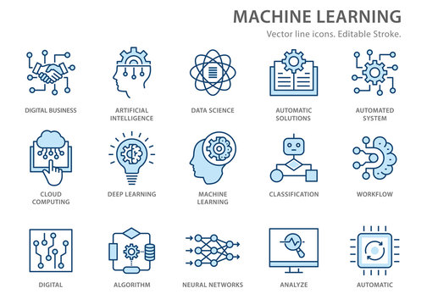






HIGH LEVEL SYSTEM ARCHITECHTURE
Web App
Audio
Customer
Call Center
Agent
ML Model
Audio Inference
Result
Web App

Slide 17
06
IMPLEMENTATION

Slide 18
IMPLEMENTATION
Finding a suitable Algorithm
Optimize the model
BUILD A MACHINE LEARNING MODEL
BACKEND IMPLEMENTATION USING PYTHON
Main Script and SER Library
GETTING A FINAL OUTPUT
Connect the UI and python scripts using Flask
Deployment in a cloud platform

Slide 19
07
TESTING

Slide 20
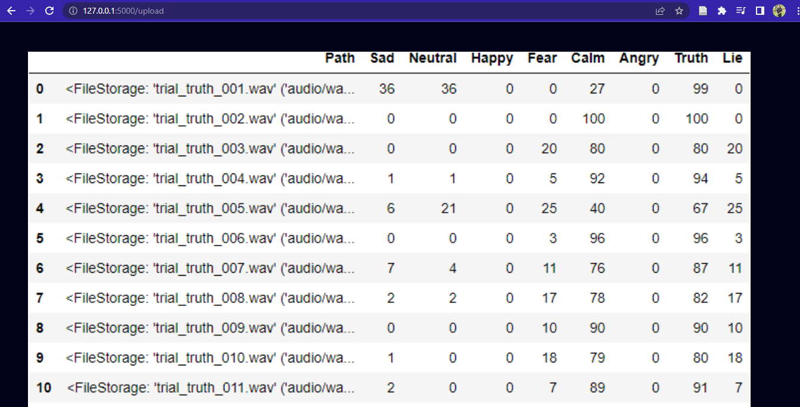
TESTING
Tested the application with the audios I collected from a GitHub project which included some truth audios and lie audios. Using those audios I was able to test and get an idea about the performance of the application.

Slide 21
08
DEPLOYMENT

Slide 22
DEPLOYMENT
AWS
Microsoft Azure
Heroku
Need AWS account and must install Docker, AWS Command Line Interface (CLI) tool, and LightSail Control (LightSailctl) plugin on the system as prerequisites
Need Azure account and can use Command Line Interface (CLI) tool for the deployment.
Also can be tested using Azure virtual machines before deployment
Basic software requirements includes Python, pip, Heroku CLI, and Git. Then after login into the Heroku CLI, need to push the code from the local to the Heroku remote

Slide 23
09
PROJECT MANAGEMENT

Slide 24
TIMELINE
Tasks | 2021 |  |  |  |  |  |  | 2022
 | June | July | Aug | Sep | Oct | Nov | Dec | Jan | Feb | Mar | Apr | May | Jun
Deciding a topic and Reading Research papers
preliminary discussions with one of the supervisors
Project planning
Preparing the project proposal and submission

Slide 25
Tasks | 2021 |  |  |  |  |  |  | 2022
 | June | July | Aug | Sep | Oct | Nov | Dec | Jan | Feb | Mar | Apr | May | Jun
Preparing proposal defending presentation
Data Collection
Data Preprocessing and feature extraction
Training and testing the model
Creating the main functionalities of the application
Testing the completed work

Slide 26
Tasks | 2021 |  |  |  |  |  |  | 2022
 | June | July | Aug | Sep | Oct | Nov | Dec | Jan | Feb | Mar | Apr | May | Jun
Creating web applications and designing the user interface
Adding some more features to the program
Preparing the thesis
Complete the Web Application

Slide 27
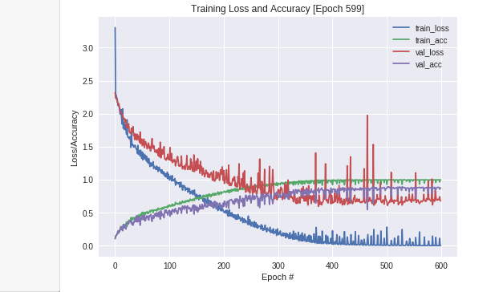
10
EVALUATION

Slide 28
EVALUATION
To evaluate the system, the first fact that has to be consider is the model accuracy. Python library provides the capability of finding the accuracy of a model as a percentage so we can get an idea about the quality of the system.
The second way is to use relevant data for the testing process. Since there are some audios collected from a GitHub project that included some lie and truth audios, I used them for testing and evaluation of the system. But the best option is to evaluate the system in a real-time situation in
an insurance company.
In other case, if it is possible to get the data from an insurance company database which they have stored audios from solved cases we can use them and evaluate our system to find out whether it’s working properly in less time. Also, we can improve the functionalities of the system by knowing the exact requirements of the companies by working in a real-time scenario with them.

Slide 29
11
CONCLUSION

Slide 30
CONCLUSION
This application is being able to predict whether the person is speaking the truth in a particular conversation without any physical contact.
In the usual context the fraud detecting application are based on NLP
and due to the language barrier, there are some limitations those
application would not solve our cases in Sri Lanka. Even the
google assistant is not being able to catch our language well.
All the research we considered in the previous chapters are based on
NLP and signal analysis. But there are no certain applications related
to the concept of lie detection.
Polygraph test which is used for criminal investigations need a
physical contact with the person who is being investigate.
So, this research mainly focuses on a novel idea of fraud detection using signal analysis and by developing it with a better dataset and better technology will help to minimize the fraudulent activities in the Insurance industry as well the industries which needs these types of fraud detection systems

Slide 31
12
REFERENCES

Slide 32
REFERENCES
[1] ‘Machine Learning Method for Detecting and Analysis of Fraud Phone Calls Datasets’, IJRTE, vol. 8, no. 6, pp. 3806–3810, Mar. 2020, doi: 10.35940/ijrte.F8751.038620.
[2] Z. Tariq, S. Shah, and Y. Lee, ‘Speech Emotion Detection using IoT based Deep Learning for Health Care’, Dec. 2019. doi: 10.1109/BigData47090.2019.9005638.
[3] J. E. Loy, H. Rohde, and M. Corley, ‘Cues to Lying May be Deceptive: Speaker and Listener Behaviour in an Interactive Game of Deception’, Journal of Cognition, vol. 1, no. 1, Art. no. 1, Sep. 2018, doi: 10.5334/joc.46.
[4] R. Derrig, ‘Insurance Fraud’, Journal of Risk and Insurance, vol. 69, pp. 271–287, Sep. 2002, doi: 10.1111/1539-6975.00026.
[5] J. Jung and B.-J. Kim, ‘Insurance Fraud in Korea, Its Seriousness, and Policy Implications’, Frontiers in Public Health, vol. 9, Nov. 2021, doi: 10.3389/fpubh.2021.791820.
[6] K. Han, D. Yu, and I. Tashev, ‘Speech Emotion Recognition Using Deep Neural Network and Extreme Learning Machine’, p. 5.

Slide 33
REFERENCES
[7] R. A. Khalil, E. Jones, M. Babar, T. Jan, M. Zafar, and T. Alhussain, ‘Speech Emotion Recognition Using Deep Learning Techniques: A Review’, IEEE Access, vol. PP, pp. 1–1, Aug. 2019, doi: 10.1109/ACCESS.2019.2936124.
[8] Abe, Toshihiko, Takao Kobayashi, and Satoshi Imai. Har-monics tracking and pitch extraction based on instanta-neous frequency. International Conference on Acoustics,Speech, and Signal Processing, ICASSP-95., Vol. 1. IEEE,1995
[9] M. Piórkowska and M. Wrobel, ‘Basic Emotions’, 2017. doi: 10.1007/978-3-319-28099-8_495-1.
[10] A. Adigwe, N. Tits, K. E. Haddad, S. Ostadabbas, and T. Dutoit, ‘The Emotional Voices Database: Towards Controlling the Emotion Dimension in Voice Generation Systems’, arXiv:1806.09514 [cs, eess]
[11] H. Cao, D. Cooper, M. Keutmann, R. Gur, A. Nenkova, and R. Verma, ‘CREMA-D: Crowd-sourced emotional multimodal actors dataset’, IEEE transactions on affective computing, vol. 5, pp. 377–390, Oct. 2014, doi: 10.1109/TAFFC.2014.2336244.
[12] C. Busso et al., ‘IEMOCAP: interactive emotional dyadic motion capture database’, Lang Resources & Evaluation, vol. 42, no. 4, pp. 335–359, Dec. 2008, doi: 10.1007/s10579-008-9076-6.

Slide 34
REFERENCES
[13] S. Yoon, S. Byun, and K. Jung, ‘Multimodal Speech Emotion Recognition Using Audio and Text’, arXiv:1810.04635 [cs]
[14] W. M. Campbell, D. E. Sturim, and D. A. Reynolds, ‘Support vector machines using GMM supervectors for speaker verification’, IEEE Signal Processing Letters, vol. 13, no. 5, pp. 308–311, May 2006, doi: 10.1109/LSP.2006.870086.
[15] Bergstra, James, Frédéric Bastien, Olivier Breuleux, PascalLamblin, Razvan Pascanu, Olivier Delalleau, GuillaumeDesjardins et al. Theano: Deep learning on gpus withpython. In NIPS 2011, BigLearning Workshop, Granada,Spain. 2011
[16] R. Connaughton, A. Sgroi, K. W. Bowyer, and P. J. Flynn, ‘A cross-sensor evaluation of three commercial iris cameras for iris biometrics’, presented at the CVPR Workshops, Jan. 2011.
[17] Schoerkhuber, Christian, and Anssi Klapuri. Constant-Qtransform toolbox for music processing. 7th Sound andMusic Computing Conference, Barcelona, Spain. 2010.
[18] S. Safavi, H. Gan, I. Mporas, and R. Sotudeh, ‘Fraud Detection in Voice-Based Identity Authentication Applications and Services’, 2016 IEEE 16th International Conference on Data Mining Workshops (ICDMW), 2016

Slide 35
THANK YOU!

